Slide 1
Working with Decision trees

Slide 2
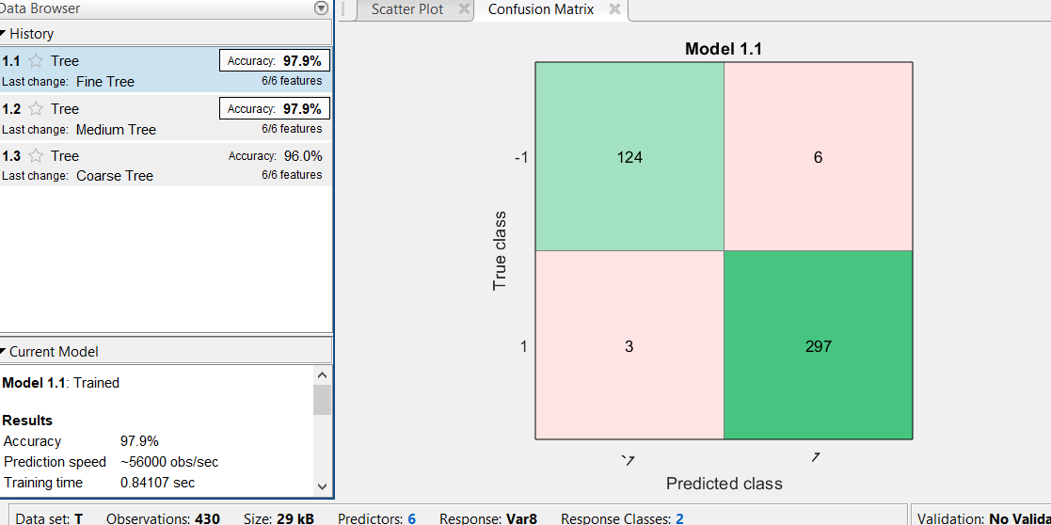
Tree2_u_u

Slide 3
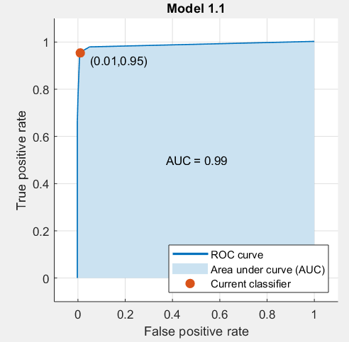
Tree_u_u

Slide 4
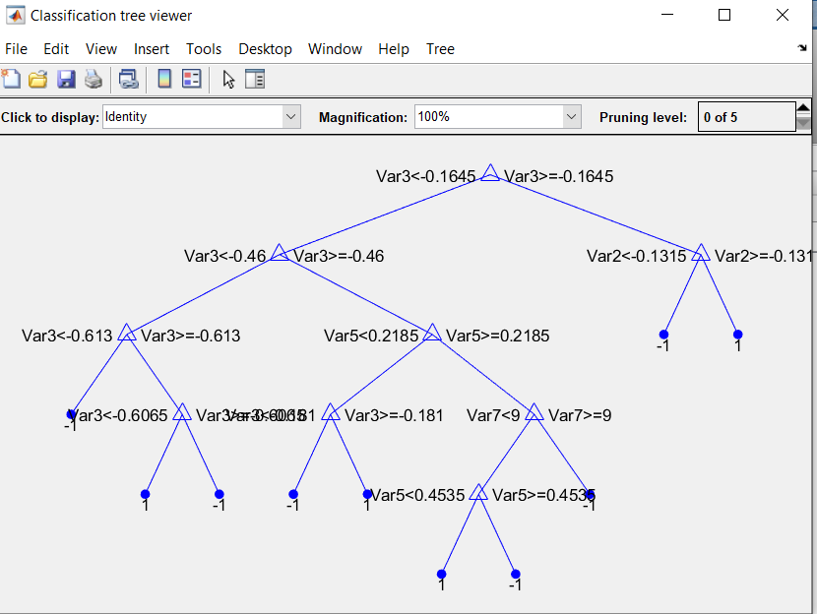
Tree2_u_u
view(Tree2_u_u.ClassificationTree,'Mode','Graph’)

Slide 5
Tree2_u_u
view(Tree2_u_u.ClassificationTree)
Decision tree for classification
1 if Var3<-0.1645 then node 2 elseif Var3>=-0.1645 then node 3 else 1
2 if Var3<-0.46 then node 4 elseif Var3>=-0.46 then node 5 else -1
3 if Var2<-0.1315 then node 6 elseif Var2>=-0.1315 then node 7 else 1
4 if Var3<-0.613 then node 8 elseif Var3>=-0.613 then node 9 else -1
5 if Var5<0.2185 then node 10 elseif Var5>=0.2185 then node 11 else -1
6 class = -1
7 class = 1
8 class = -1
9 if Var3<-0.6065 then node 12 elseif Var3>=-0.6065 then node 13 else -1
10 if Var3<-0.181 then node 14 elseif Var3>=-0.181 then node 15 else -1
11 if Var7<9 then node 16 elseif Var7>=9 then node 17 else 1
12 class = 1
13 class = -1
14 class = -1
15 class = 1
16 if Var5<0.4535 then node 18 elseif Var5>=0.4535 then node 19 else 1
17 class = -1
18 class = 1
19 class = -1

Slide 6
Tree2_u_u
>> label_2_u_u=resubPredict(Tree2_u_u.ClassificationTree);
>> confusionmat(Tree2_u_u.ClassificationTree.Y,label_2_u_u)
ans =
124 6
3 297

Slide 7
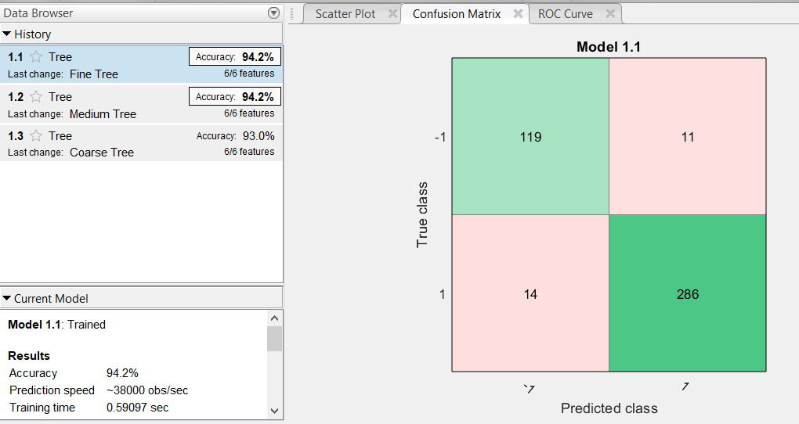
Tree2_v_u

Slide 8
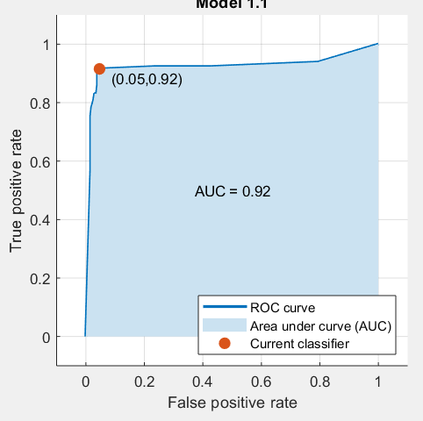
Tree2_v_u

Slide 9
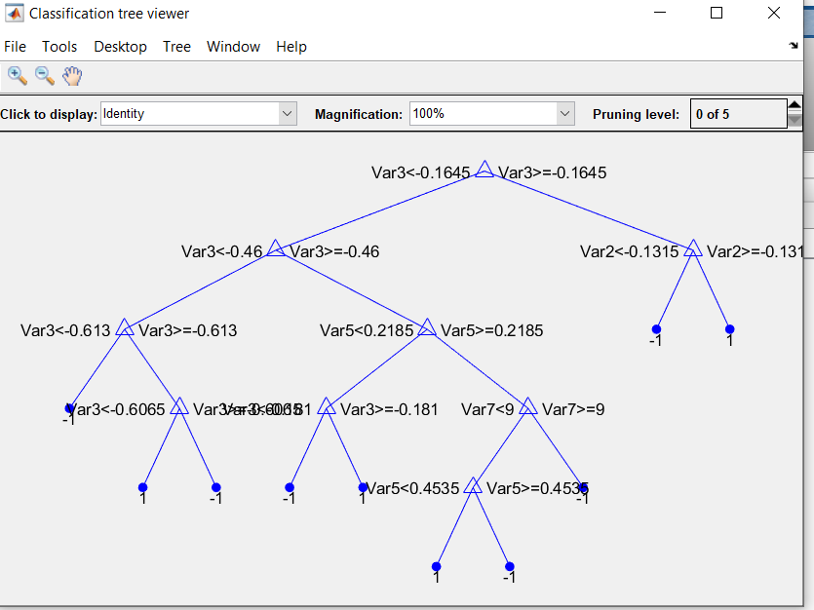
Tree2_v_u
>> view(Tree2_v_u.ClassificationTree,'Mode','Graph')

Slide 10
Tree2_v_u
>> label_2_v_u=resubPredict(Tree2_v_u.ClassificationTree);
>> confusionmat(Tree2_v_u.ClassificationTree.Y,label_2_v_u)
ans =
124 6
3 297

Slide 11
Exported Model from Classification Learner
A model exported from the classification learner is is always the one that corresponds to the “no-validation” option, even if the validation options is chosen.

Slide 12
Tree_2_u_o
Tree2_u_o=fitctree(Predictors,Response,'OptimizeHyperparameters','auto');

Slide 13
Tree_2_u_o

Slide 14
Tree_2_u_o

Slide 15
Tree_2_u_o

Slide 16
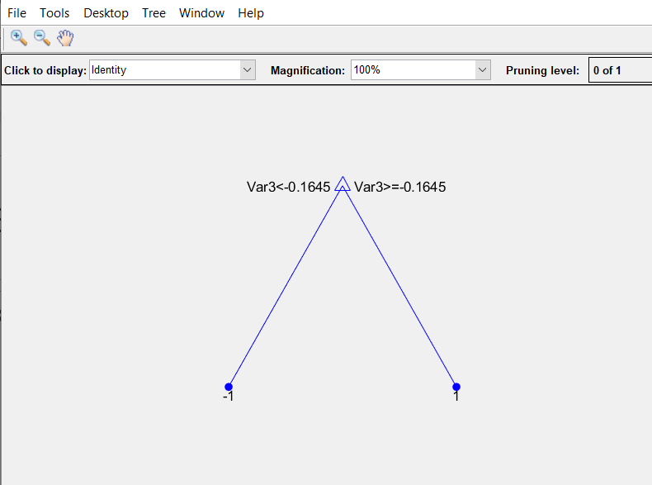
Tree_2_u_o

Slide 17
Tree_2_u_o
>>label_2_u_o=resubPredict(Tree2_u_o);
>> confusionmat(Tree2_u_o.Y,label_2_u_o)
ans =
126 4
17 283

Slide 18
Tree_2_c_o
Tree2_c_o = fitctree(Predictors,Response,...
'OptimizeHyperparameters','auto',...
'HyperparameterOptimizationOptions',struct('KFold',5));
view(Tree2_c_o,'Mode','Graph')

Slide 19
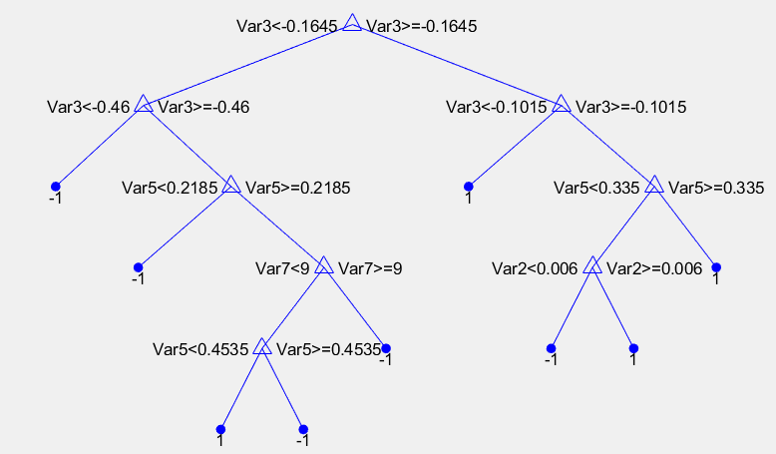
Tree_2_c_o

Slide 20
Tree_2_c_o
>>label_2_c_o=resubPredict(Tree2_c_o);
>> confusionmat(Tree2_c_o.Y, label_2_c_o)
ans =
125 5
5 295

Slide 21
Pruning the tree
Pruning optimizes tree depth (leafiness) by merging leaves on the same tree branch.
To prune a tree, the tree must contain a pruning sequence. By default, both fitctree and fitrtree calculate a pruning sequence for a tree during construction.
Example:
tree1 = prune(tree,'Level',6);
Can be done interactively on a graph

